Slide 1
Shell Bootcamp 2024 3 Reflections for Week 2
Cherry Chopra
Date : 06-Sep-2024

Slide 2

About Me
Everything happens for a reason.

Slide 3

My learnings from this week!

Slide 4
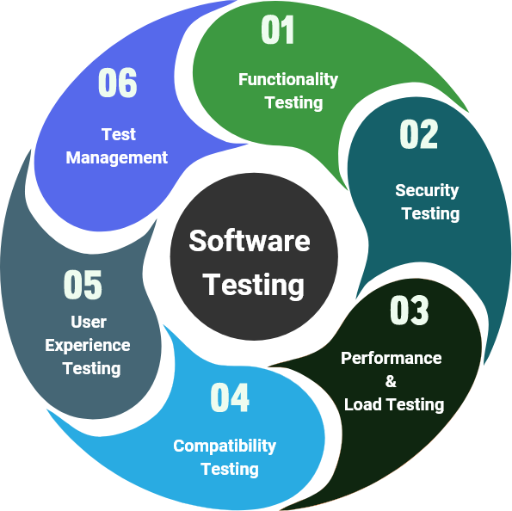
Learning 1 | My takeaways
Key learning:
Software Testing fundamentals and techniques
Key takeaway:
Understood what testing is and its different types that can be used for different purposes. Refreshed the software testing lifecycle and the various benefits of testing early.
How do I personally see this concept implemented in the Energy sector:
Testing the various solutions developed and ensuring they’re bug free, enhancing security which is of critical importance in the energy sector.

Slide 5
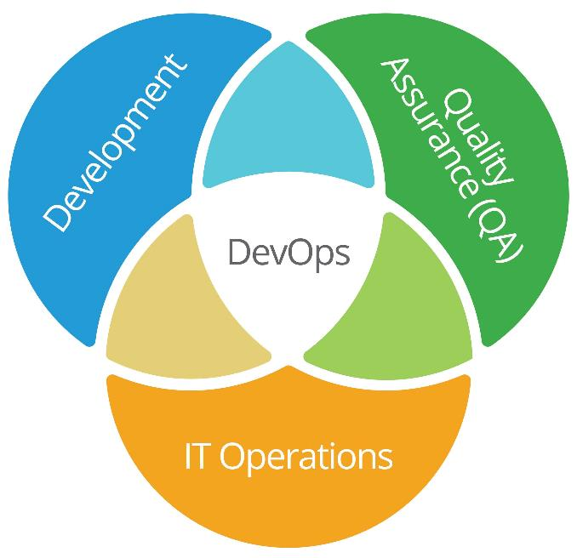
Learning 2 | My takeaways
Key learning:
Fundamentals of DevOps and its importance and benefits.
Key takeaway:
Understood why DevOps was developed and how its ancestors influenced its current form. Learnt about the continuous integration and continuous deployment and delivery pipeline. DevOps life cycle, principle and benefits.
How do I personally see this concept implemented in the Energy sector:
Bridges the gap between Development teams and the Operations team making it better for customer satisfaction and business profits.

Slide 6
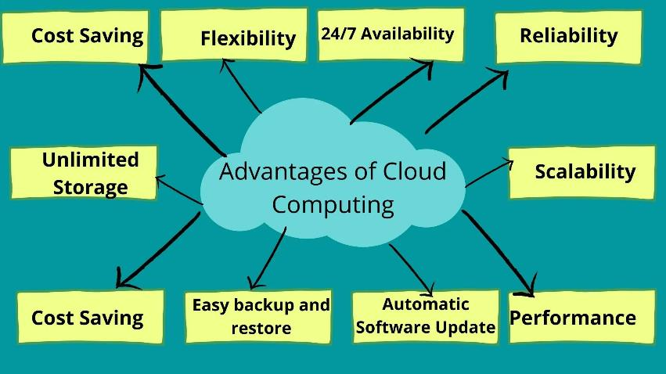
Learning 3 | My takeaways
Key learning:
GitHub Actions and Cloud Computing Fundamentals and Basic Implementation
Key takeaway:
Understood basics of GitHub and GitHub Actions – workflow, events, runners, jobs, actions etc. Learnt how to use the push and pull commands and also the basics of cloud computing along with creating a virtual machine.
How do I personally see this concept implemented in the Energy sector:
Using cloud-based solutions could help in cost cutting and increasing profits along with enhancing security.

Slide 7

Relevance of learnings for my organization

Slide 8
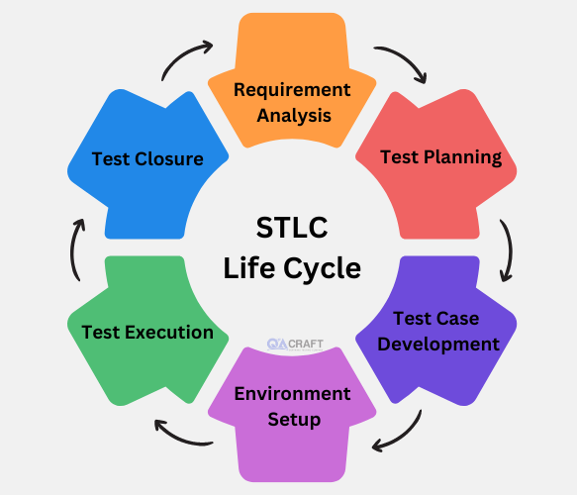
Learning 1 | Relevance for Shell
How I feel Shell implements this learning:
Shell performs intensive testing on all the software it uses and develops, ensuring proper functionality and error-free functioning of the organization processes.
How I feel Shell benefits from this learning:
Shell ensures error-free and smooth functioning of its software, preventing losses due to any delays or mishaps of the virtual systems through testing and ensuring everything is working as intended and in sync.

Slide 9
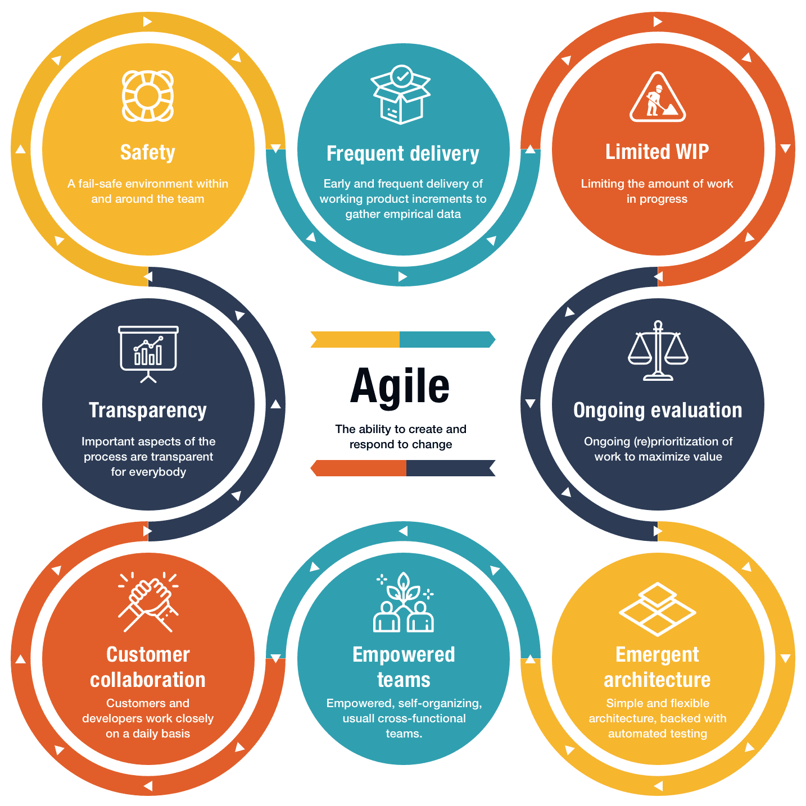
Learning 2 | Relevance for Shell
How I feel Shell implements this learning:
Shell leverages DevOps and Scrum, both agile methodologies of Software Development to benefit from their flexibility and the same time allowing for collaboration between different teams and within a team.
How I feel Shell benefits from this learning:
Shell is able to leverage the benefits of agile methods like flexibility, quicker solutions, team collaboration, continuous improvement, adaptability etc.

Slide 10
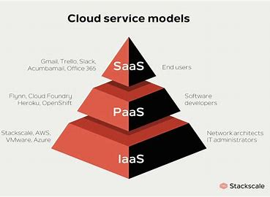
Learning 3 | Relevance for Shell
How I feel Shell implements this learning:
Shell uses cloud-based SaaS like PowerBI and PowerApps. IaaS like Azure is also used.
How I feel Shell benefits from this learning:
Shell is able to reduce costs and efforts in infrastructure maintenance and is able to enhance accessibility through storing data on and using services on the cloud. It also enhances security and reduces risk.

Slide 11

Challenges in implementing learning

Slide 12
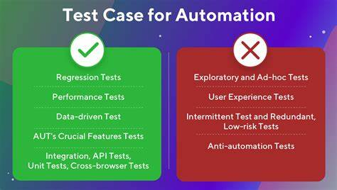
Challenge faced while implementing Learning 1
What were the challenges I faced while implementing Learning 1 and my plan to overcome them:
Automating test cases and distinguishing STLC stages in real time.

Slide 13
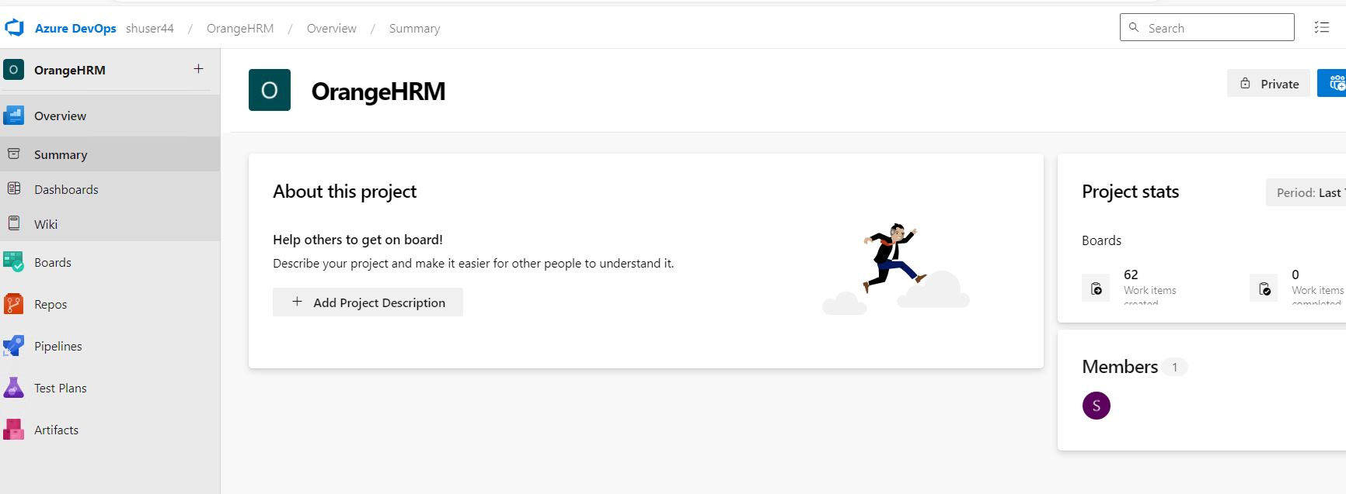
Challenge faced while implementing Learning 2
What were the challenges I faced while implementing Learning 2 and my plan to overcome them:
Understanding the real-life application of DevOps and understanding its full functionality and application.

Slide 14
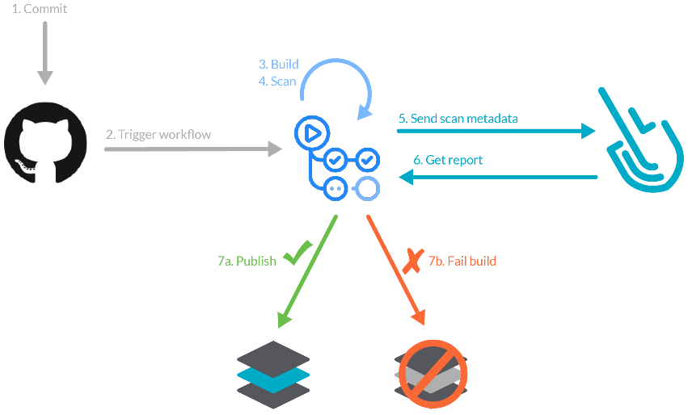
Challenge faced while implementing Learning 3
What were the challenges I faced while implementing Learning 3 and my plan to overcome them:
Understanding workflows, events, runners and jobs and how to implement them along with GitHub commands.

Slide 15

Learning is also Fun!

Slide 16
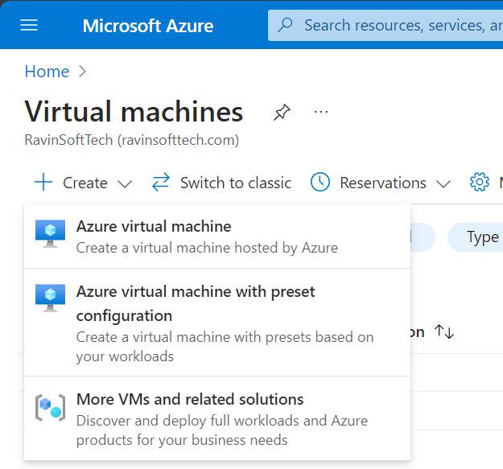
Learning is also Fun!
We practiced DevOps, GitHub actions and Cloud hands-on on our systems and were able to create test cases on DevOps, YAML files of GitHub and VirtualMachines using Microsoft Azure.

Slide 17
Thank You

